Slide 1
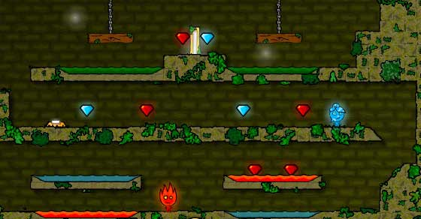

Captivity
Eduardo Skapinakis - 98811
Miguel Lahera Hervilla - 98072
Rodrigo Carvalho - 90631
Rui Melo - 98823
Inspiration: Fire Boy & Water Girl

Slide 2
Captivity
Windows PC Game
2D Platformer
Cooperative game
Inspiration: Fire Boy & Water Girl

Slide 3
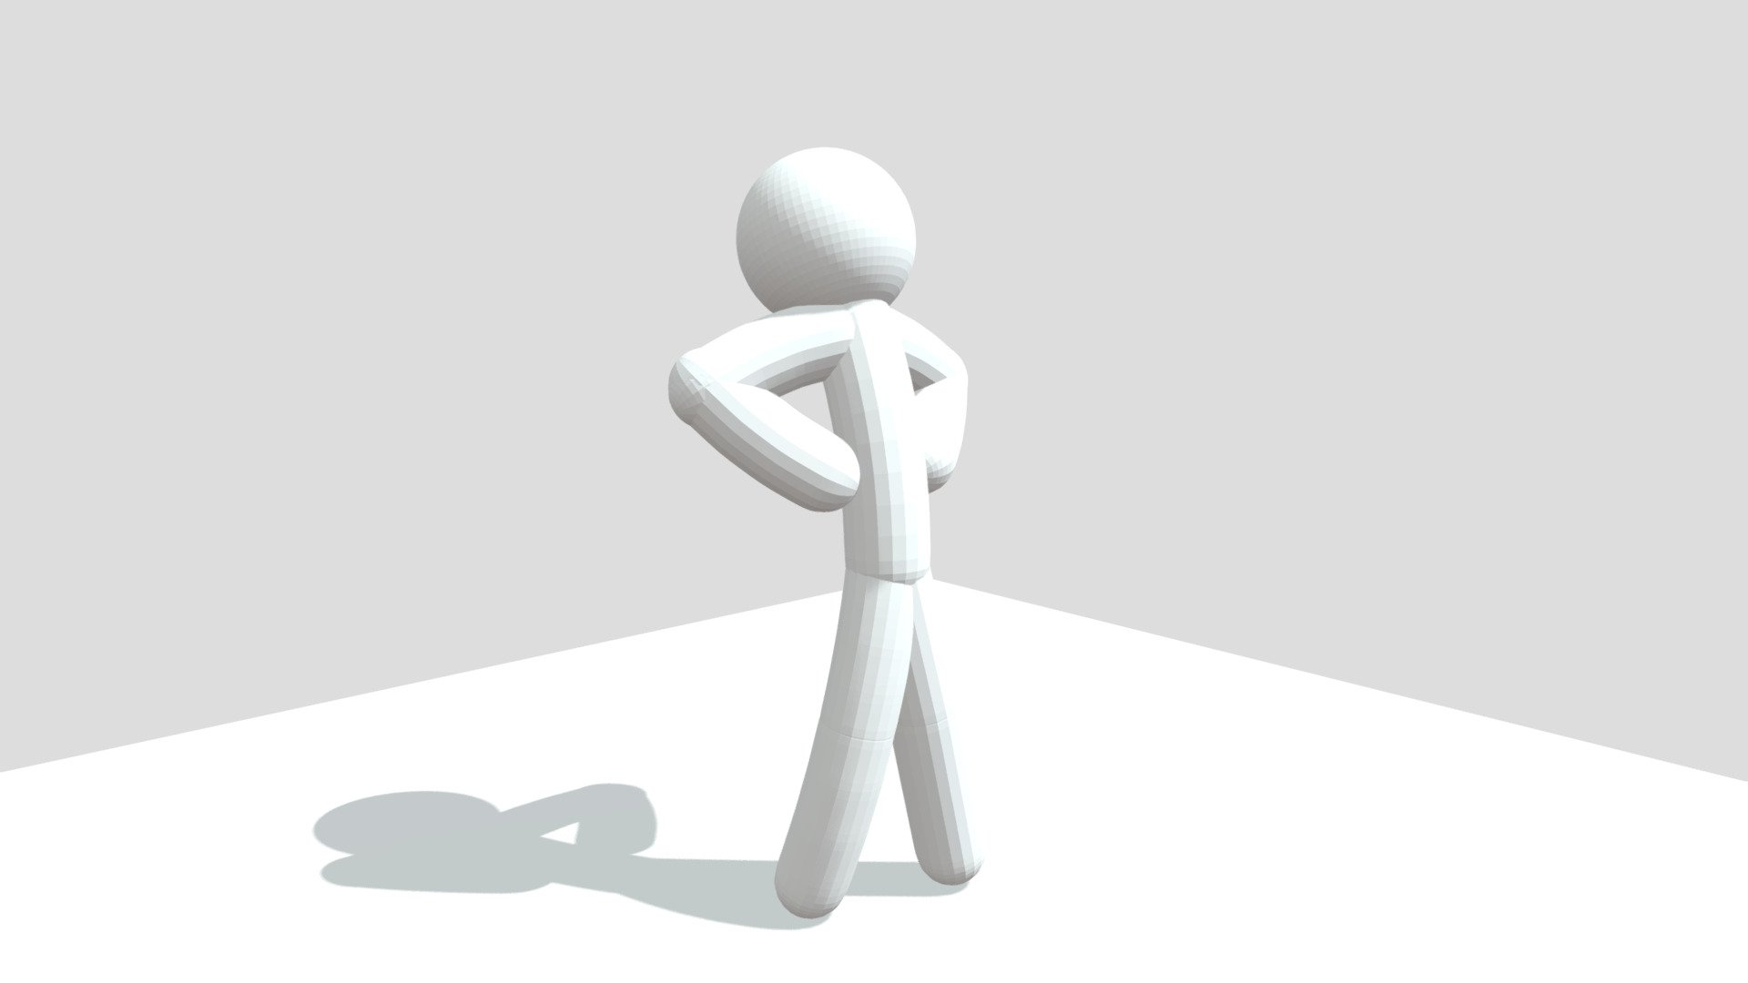
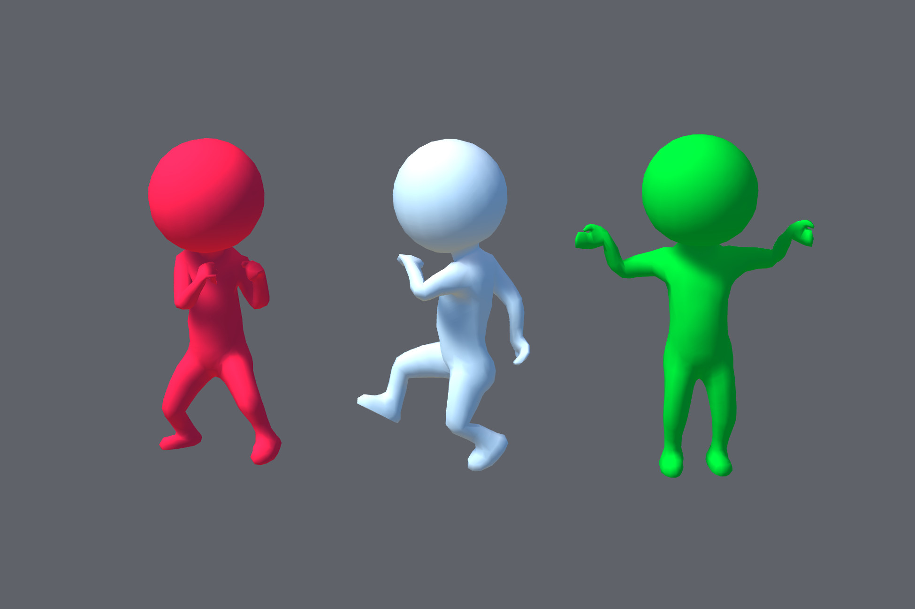
Character Design:
The game is played with 2 human characters which have a stickman-like design.
The spirits that they free are also human-like but with colors referring to their elements

Slide 4
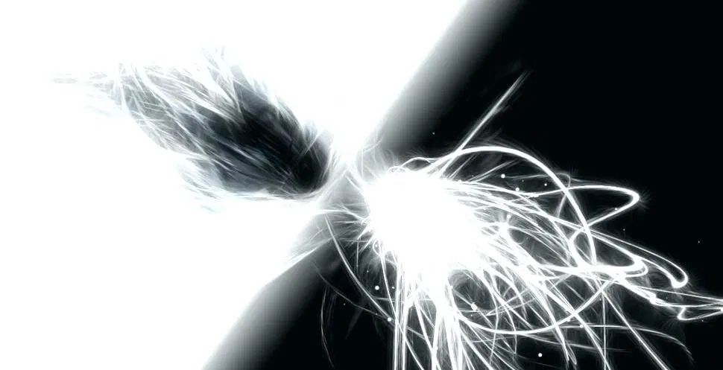
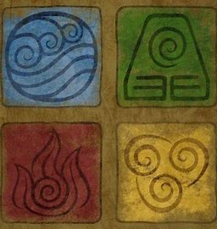
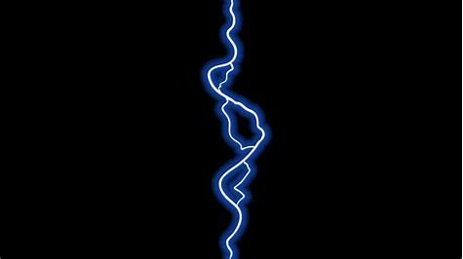
There are seven spirits each controlling an element:
Electricity
Ground
Air
Water
Fire
Dark
Light

Slide 5
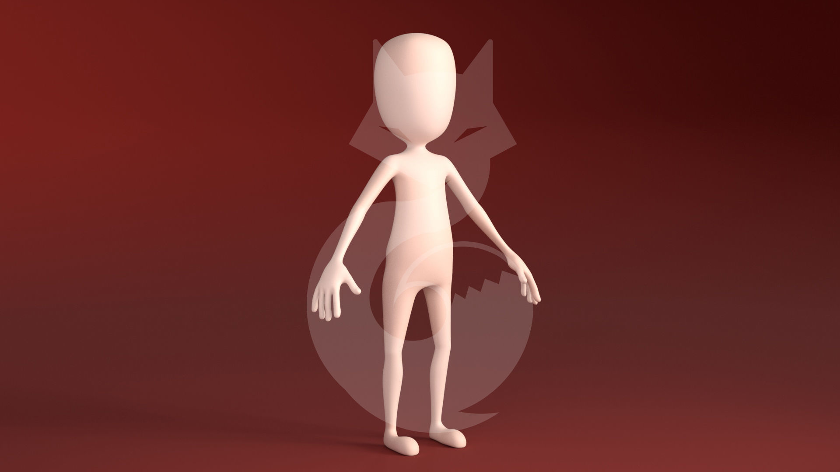

Humans, Spirits and Elementals:
As humans, we start with no powers
In some levels we unlock spirits, who grant us the ability to change into elementals. As an elemental, we get to control the element of the spirit we freed
New character unlocked

Slide 6
Character abilities:
As humans:
Basic movements (right, left, up and down)
Change into an elemental: Each character can change into an elemental
As elementals:
Basic movements
Change to another elemental or back into a human
Base power: Throw themed projectiles
Fuse and split: Some elementals can fuse into another one
Combination: Some elementals can combine their power to enact a new ability

Slide 7
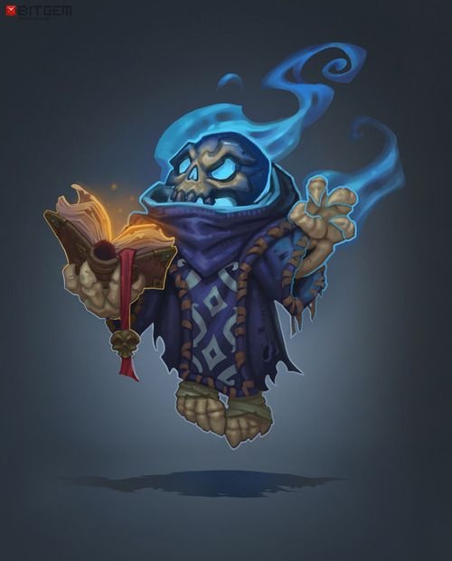
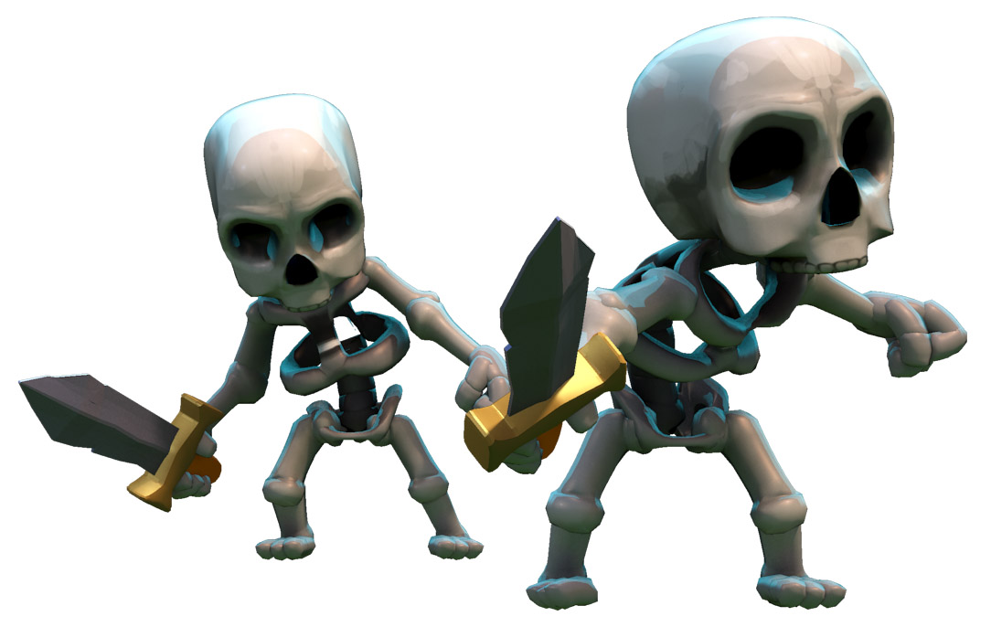
Motivations:
Escape wizards tower
Kill the wizard and other enemies
Free the other spirits
Learn the abilities of each character and their combinations

Slide 8
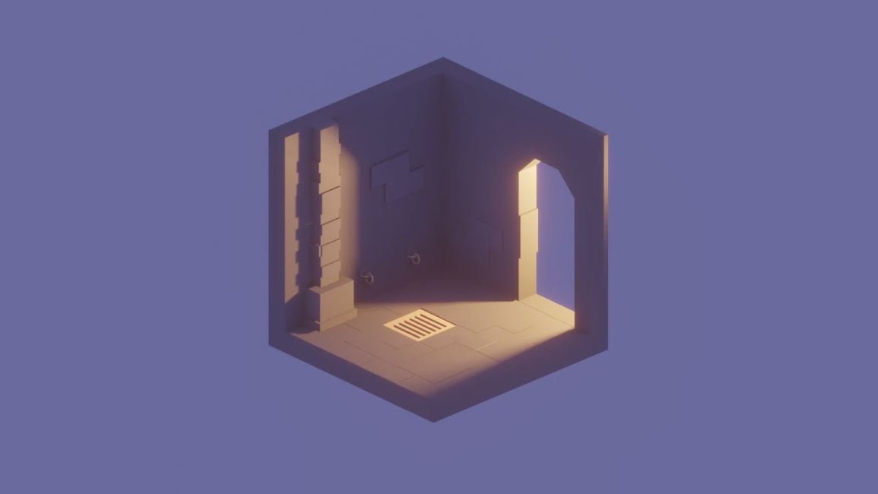
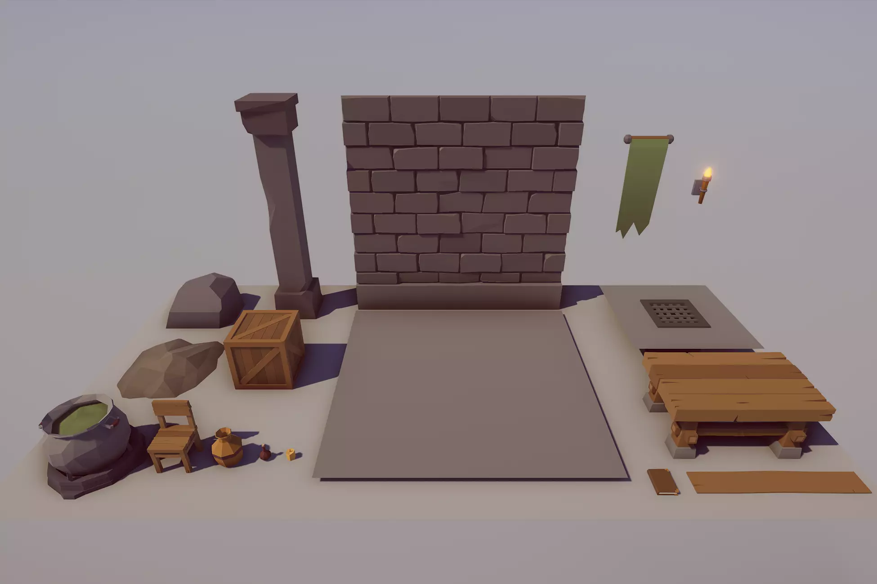
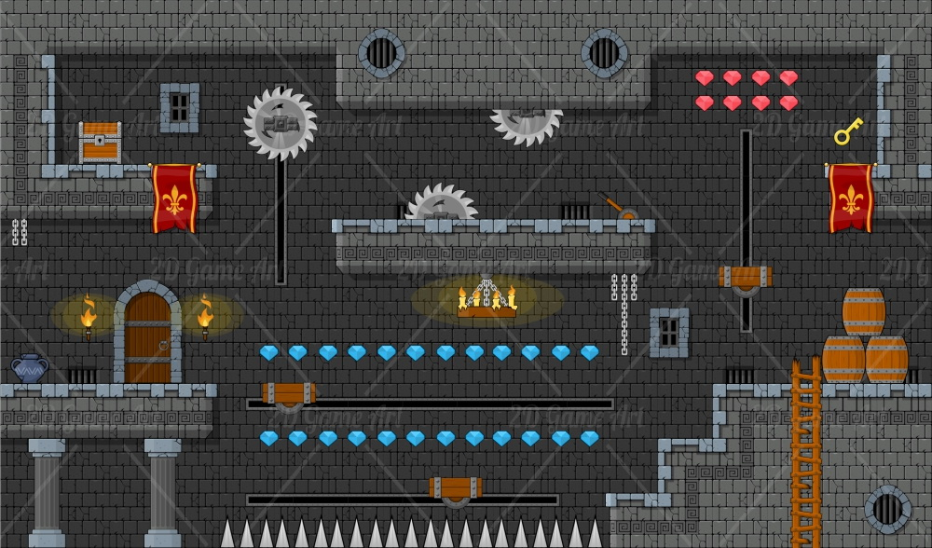
Visuals:
Old castle with traps
Characters that resemble human beings

Slide 9
Concept Value:
Action: Fight your enemies
Strategy: Find the right combinations of characters to overcome the traps and maximize your power.
Explore the combined powers
Try different combinations
Unlock hidden secrets

Slide 10
The End
Any questions?

